Slide 1
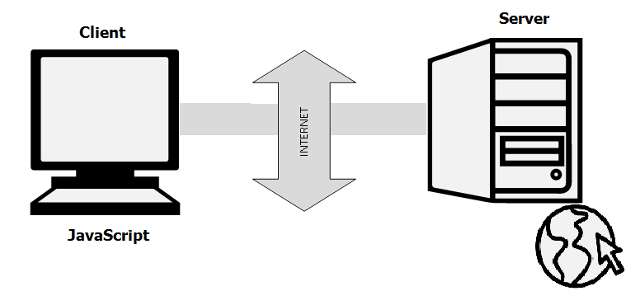
What is JavaScript
JavaScript is a very powerful client-side scripting language. JavaScript is used mainly for enhancing the interaction of a user with the webpage. In other words, you can make your webpage more lively and interactive, with the help of JavaScript. JavaScript is also being used widely in game development and Mobile application development.
Javascript History
JavaScript was developed by Brendan Eich in 1995, which appeared in Netscape, a popular browser of that time.

Slide 2
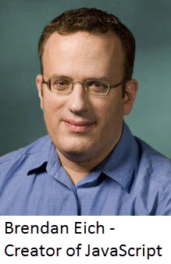
The language was initially called LiveScript and was later renamed JavaScript. There are many programmers who think that JavaScript and Java are the same. In fact, JavaScript and Java are very much unrelated. Java is a very complex programming language whereas JavaScript is only a scripting language. The syntax of JavaScript is mostly influenced by the programming language C.
A Simple JavaScript Program
You should place all your JavaScript code within <script> … </script> tag and if you are keeping your JavaScript code within the HTML document itself. This helps your browser distinguish your JavaScript code from the rest of the code.

Slide 3
Hello World Example: <html> <head> <title>My First JavaScript code!!!</title> <script type="text/javascript"> alert("Hello World!"); </script> </head> <body> </body> </html> Summary: 1. JavaScript is a client-side scripting anguage developed by Brendan Eich. 2. JavaScript can be run on any operating systems and almost all web browsers. 3. You need a text editor to write JavaScript code and a browser to display your web page.

Slide 4
JavaScript Display Possibilities
JavaScript can "display" data in different ways:
Writing into an HTML element, using innerHTML.
Writing into the HTML output using document.write().
Writing into an alert box, using window.alert().
Using innerHTML
To access an HTML element, JavaScript can use the document.getElementById(id) method.
Exampale 1. <html>
<body>
<h2>My First Web Page</h2>
<p id="demo"></p>
<script>
document.getElementById("demo").innerHTML = 15 + 26;
</script>
</body>
</html>

Slide 5
Using document.write()
For testing purposes, it is convenient to use document.write()
Exampale 2. <html>
<body>
<h2>My First Web Page</h2>
<script> document.write(5 + 6); </script>
</body>
</html>
Exampale 3. <html>
<body>
<h2>My First Web Page</h2>
<button type="button" onclick="document.write(5 + 6)">Try it</button> </body>
</html>

Slide 6
Using window.alert()
You can use an alert box to display data:
Exampale 4. <html>
<body>
<h2>My First Web Page</h2>
<script> window.alert(5 + 6); </script>
</body>
</html>
JavaScript Keywords
JavaScript statements often start with a keyword to identify the JavaScript action to be performed.

Slide 7
Keyword | Description
var | Declares a variable
let | Declares a block variable
const | Declares a block constant
if | Marks a block of statements to be executed on a condition
switch | Marks a block of statements to be executed in different cases
for | Marks a block of statements to be executed in a loop
function | Declares a function
return | Exits a function
try | Implements error handling to a block of statements

Slide 8
What are Variables Variables are containers for storing data (storing data values). In this example, x, y, and z, are variables, declared with the var keyword: EXAMPLE1: example2:
JavaScript Let
JavaScript let is a keyword used to declare variables in JavaScript that are block scoped.
Block Scope: The variables which are declared inside the { } block are known as block-scoped variables. variables declared by the var keyword cannot be block-scoped.
Example1: Example2:

Slide 9
Javascript Operators
JavaScript includes operators same as other languages. An operator performs some operation on single or multiple operands (data value) and produces a result. JavaScript includes following categories of operators.
Arithmetic Operators
Arithmetic operators are used to perform mathematical operations between numeric operands.
Operator | Description
+ | Adds two numeric operands.
- | Subtract right operand from left operand
* | Multiply two numeric operands.
/ | Divide left operand by right operand
% | Modulus operator. Returns remainder of two operands.
++ | Increment operator. Increase operand value by one
-- | Decrement operator. Decrease value by one

Slide 10
Example 1: JavaScript Arithmatic Operators
Example 2:++&--Operators
Example 3:String ConcatOperators
Comparison Operators
JavaScript provides comparison operators that compare two operands and return a boolean value true or false.
Operators | Description
== | Compares the equality of two operands without considering type.
=== | Compares equality of two operands with type.
!= | Compares inequality of two operands.
> | Returns a boolean value true if the left-side value is greater than the right-side value; otherwise, returns false.
< | Returns a boolean value true if the left-side value is less than the right-side value; otherwise, returns false.
>= | Returns a boolean value true if the left-side value is greater than or equal to the right-side value; otherwise, returns false.
<= | Returns a boolean value true if the left-side value is less than or equal to the right-side value; otherwise, returns false.

Slide 11
EXAMPLE 1: comparison operator
Logical Operators
In JavaScript, the logical operators are used to combine two or more conditions. JavaScript provides the following logical operators.
Operator | Description
&& | && is known as AND operator. It checks whether two operands are non-zero or not (0, false, undefined, null or "" are considered as zero). It returns 1 if they are non-zero; otherwise, returns 0.
|| | || is known as OR operator. It checks whether any one of the two operands is non-zero or not (0, false, undefined, null or "" is considered as zero). It returns 1 if any one of of them is non-zero; otherwise, returns 0.
! | ! is known as NOT operator. It reverses the boolean result of the operand (or condition). !false returns true, and !true returns false.
EXAMPLE 1: Logical Operators
Assignment Operators
JavaScript provides the assignment operators to assign values to variables with less key strokes.

Slide 12
Assignment operators | Description
= | Assigns right operand value to the left operand.
+= | Sums up left and right operand values and assigns the result to the left operand.
-= | Subtract right operand value from the left operand value and assigns the result to the left operand.
*= | Multiply left and right operand values and assigns the result to the left operand.
/= | Divide left operand value by right operand value and assign the result to the left operand.
%= | Get the modulus of left operand divide by right operand and assign resulted modulus to the left operand.
EXAMPLE 1: Assignment Operator
Ternary Operator
JavaScript provides a special operator called ternary operator :? that assigns a value to a variable based on some condition. This is the short form of the if else condition.
Syntax: <condition> ? <value1> : <value2>;

Slide 13
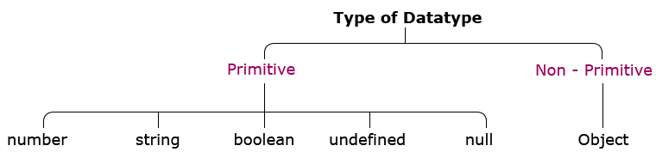
The ternary operator starts with conditional expression followed by the ? operator. The second part (after ? and before :) will be executed if the condition turns out to be true. Suppose, the condition returns false, then the third part (after :) will be executed. EXAMPLE:1 Ternary Operator
JavaScript Data Types
JavaScript includes data types similar to other programming languages like Java or C#. JavaScript is dynamic and loosely typed language. It means you don't require to specify a type of a variable.
Primitive
Numbers: Unlike many other programming languages, JavaScript does not define different types of numbers, like integers, short, long, floating-point etc.
String: JavaScript strings are used for storing and manipulating text.

Slide 14
Boolean: The boolean (not Boolean) is a primitive data type in JavaScript. It can have only two values: true or false. It is useful in controlling program flow using conditional statements like if else, switch, while loop, etc. exm.1 , exm.2, exm.3
Undefined: Undefined is also a primitive value in JavaScript. A variable or an object has an undefined value when no value is assigned before using it. So you can say that undefined means lack of value or unknown value. exm1
Null:This is another special data type that can have only one value-the null value. A null value means that there is no value. It is not equivalent to an empty string ("") or 0, it is simply nothing.Exam1
Non Primitive
1. Object: JavaScript object is a standalone entity that holds multiple values in terms of properties and methods. Object property stores a literal value and method represents function.exm1

Slide 15
JavaScript Conditional Statements
Very often when you write code, you want to perform different actions for different decisions.
You can use conditional statements in your code to do this.
if Statement
Use the if statement to specify a block of JavaScript code to be executed if a condition is true. exam1
Stantax: if(expression)
{
//content to be evaluated
}
If...else Statement
It evaluates the content whether condition is true of false. exam1
Stantax: if(expression){
//content to be evaluated if condition is true
}
else{
//content to be evaluated if condition is false
}

Slide 16
If...else if statement
It evaluates the content only if expression is true from several expressions.Exam1
Syntax: if(expression1){
//content to be evaluated if expression1 is true
}
else if(expression2){
//content to be evaluated if expression2 is true
}
else if(expression3){
//content to be evaluated if expression3 is true
}
else{
//content to be evaluated if no expression is true
}
JavaScript Loops
The JavaScript loops are used to iterate the piece of code using for, while, do while or for-in loops. It makes the code compact. It is mostly used in array.

Slide 17
JavaScript For loop
The JavaScript for loop iterates the elements for the fixed number of times. It should be used if number of iteration is known. Exam1
Syntax: for (initialization; condition; increment)
{
code to be executed
}
JavaScript while loop
The JavaScript while loop iterates the elements for the infinite number of times. It should be used if number of iteration is not known. Exam1
Syntax: while (condition)
{
code to be executed
}
JavaScript do while loop
The JavaScript do while loop iterates the elements for the infinite number of times like while loop. But, code is executed at least once whether condition is true or false. Exam 1
Syntax: do
{
code to be executed
}
while (condition);

Slide 18
JavaScript Switch Statement
Use the switch statement to select one of many code blocks to be executed. Exam1
Exam2 Santax:switch(expression)
{ case x: // code block break; case y: // code block break; default: // code block }
JavaScript Array
An array is a special variable, which can hold more than one value at a time . JavaScript array is an object that represents a collection of similar type of elements.
There are 3 ways to construct array in JavaScript
By array literal
By creating instance of Array directly (using new keyword)
By using an Array constructor (using new keyword)

Slide 19
JavaScript array literal
The syntax of creating array using array literal is given below:
Syantax: var arrayname=[value1,value2.....valueN];
As you can see, values are contained inside [ ] and separated by , (comma). Exam 1
JavaScript Array directly (new keyword)
The syntax of creating array directly is given below:
var arrayname=new Array();
Here, new keyword is used to create instance of array. Exam 2
JavaScript array constructor (new keyword)
Here, you need to create instance of array by passing arguments in constructor so that we don't have to provide value explicitly. Exam 3
JavaScript Array Methods
Converting Arrays to Strings
The JavaScript method toString() converts an array to a string of (comma separated) array values. Exam 1
Pushing
The push() method adds a new element to an array (at the end): Exam1

Slide 20
Sorting Arrays
The sort() method sorts an array alphabetically: Exam 1
Reversing an Array
The reverse() method reverses the elements in an array.
You can use it to sort an array in descending order:Exam1
JavaScript Functions
JavaScript provides functions similar to most of the scripting and programming languages.
In JavaScript, a function allows you to define a block of code, give it a name and then execute it as many times as you want.
A JavaScript function can be defined using function keyword. EXAM1, EXAM2
Syntax:
//defining a function
function <function-name>()
{
// code to be executed
};
//calling a function
<function-name>();

Slide 21
Function Parameters
A function can have one or more parameters, which will be supplied by the calling code and can be used inside a function. JavaScript is a dynamic type scripting language, so a function parameter can have value of any data type. EXAM3 , EXAM4
Calling a Function
To invoke a function somewhere later in the script, you would simply need to write the name of that function as shown in the following code. EXAM 1
Return Value
A function can return zero or one value using return keyword. EXAM1
JavaScript a Anonymous Function
Allows us to define a function without any name. This unnamed function is called anonymous function. Anonymous function must be assigned to a variable. EXAM 1

Slide 22
JavaScript Events
The change in the state of an object is known as an Event. In html, there are various events which represents that some activity is performed by the user or by the browser. When javascriptcode is included in HTML, js react over these events and allow the execution. This process of reacting over the events is called Event Handling. Thus, js handles the HTML events via Event Handlers.
For example, when a user clicks over the browser, add js code, which will execute the task to be performed on the event.
Event Performed | Event Handler | Description
click | onclick | When mouse click on an element
mouseover | onmouseover | When the cursor of the mouse comes over the element
mouseout | onmouseout | When the cursor of the mouse leaves an element
mousedown | onmousedown | When the mouse button is pressed over the element
mouseup | onmouseup | When the mouse button is released over the element
mousemove | onmousemove | When the mouse movement takes place.

Slide 23
JavaScript HTML DOM Animation
Keyboard events:
Event Performed | Event Handler | Description
Keydown & Keyup | onkeydown & onkeyup | When the user press and then release the key
EXAM1 , EXAM2, EXAM3, EXAM4, Exam5,
To demonstrate how to create HTML animations with JavaScript, we will use a simple web page.
Animation Code
JavaScript animations are done by programming gradual changes in an element's style.
The changes are called by a timer. When the timer interval is small, the animation looks continuous.
EXAM1, EXAM2, EXAM3

Slide 24

JavaScript Form Validation
Validation is a method to authenticate the user. JavaScript provides the facility to validate the form on the client-side so data processing will be faster than server-side validation. It is preferred by most of the web developers. Through JavaScript, we can validate name, password, email, date, mobile numbers and more fields.

Slide 25
Client-side validation prevents the client from knowing whether the form is okay before reloading a page. Whereas, Server-side validation is important due to the fact that client-side validation can be completely bypassed by turning off JavaScript.
JavaScript Validation: Example
The following example is a code in HTML, CSS, and JavaScript to validate a form where:
HTML is used to create the form.
JavaScript is used to validate the form.
abhisekmahapatro424@gmail.com
nayakjagankumar79@gmail.com

